Slide 1

ANPR Model For Smart Parking System
INTERNSHIP 2
C H UDAY KUMAR
BU22CSEN0300538
Dept of Computer Science & Engineering

Slide 2
Abstract
The ANPR system operates in real-time, enabling license plate recognition directly from live webcam streams, recorded video files, or still images. The pipeline includes several key components: vehicle detection, license plate localization, plate image enhancement, character segmentation, and finally, OCR-based text extraction. Deep learning models, such as Convolutional Neural Networks (CNNs), are used for object detection (vehicles and plates), ensuring high accuracy even in challenging conditions such as varying lighting, occlusion, and complex backgrounds.
Dept of Computer Science & Engineering

Slide 3
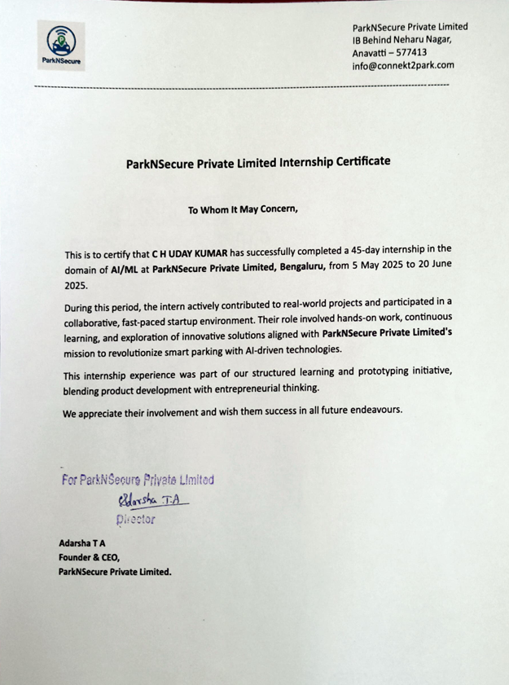
Certificate
Dept of Computer Science & Engineering

Slide 4
Company Overview
ParkNSecure is a smart tech company providing urban mobility solutions.
Specializes in smart parking through its flagship product: SecurePark.
Offers hardware-software integrated solutions for real-time parking.
Focus on sustainability, automation, and urban mobility innovation.
Solutions are deployed across public and private parking infrastructures.
Aims to reduce traffic congestion and enhance smart city development.
Dept of Computer Science & Engineering

Slide 5
Project Overview
Project Title: ANPR Model For Smart Parking System
Problem Domain: Urban traffic congestion & inefficient manual parking
Project Goal: Build a responsive and Automated license plate Detector
Key Features:
Real-time license plate detection
Number extraction and analyzation.
Barricade opening if the number plate is registered.
Dept of Computer Science & Engineering

Slide 6
Internship Work Description
Dataset Preparation and Annotation for YOLOv8
Training the YOLOv8 Model for License Plate Detection .
Developing Detection Scripts for Real-Time and Batch Processing
Focused on Indian License Plates
Prebooked Plate Verification for Access Control
System Testing and Real-Time Optimization
Dept of Computer Science & Engineering

Slide 7
Results and Observations
Developed and trained a custom YOLOv8 model
Integrated real-time License plate Detection
Improved license plate number extraction
Maintained detailed reports and documentation.
Enhanced user experience through consistent Monitoring and Security
Dept of Computer Science & Engineering

Slide 8
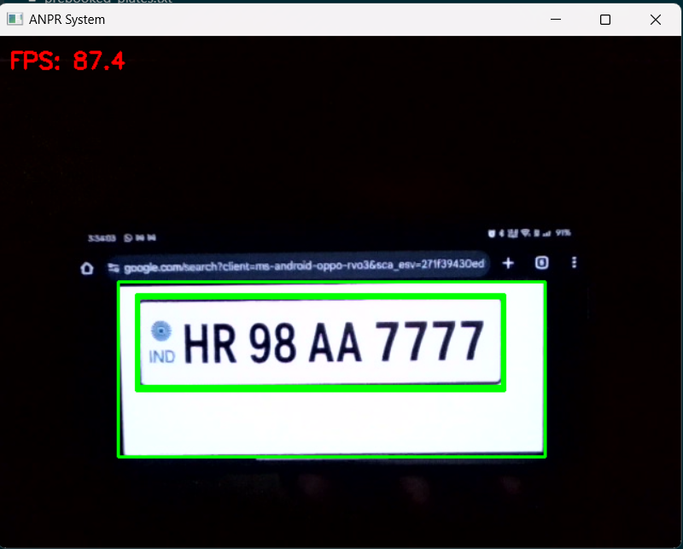
Description:-The above figure represented that the trained ANPR Model is Detecting the license plate and capturing the numbers in the number plate and sending signals to barriers to open gate or not.

Slide 9
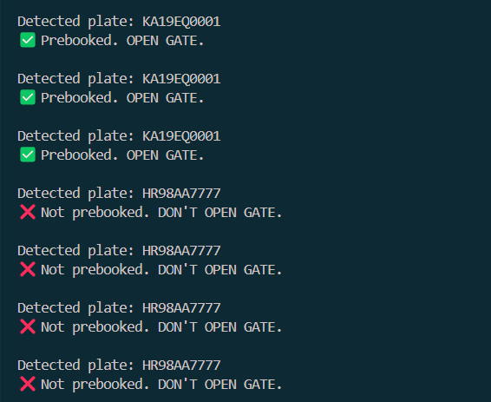
Output:-The below figure shows that when an detected plate is in the prebooked list , then it gives the permission to open the gate or else it will not allow to open the gate.
Dept of Computer Science & Engineering

Slide 10
conclusion
This ANPR project successfully demonstrates a practical and effective solution for automated vehicle license plate recognition by combining modern deep learning techniques with robust OCR technologies. By leveraging YOLOv8 for license plate detection and integrating OCR engines like Tesseract and EasyOCR for text recognition, the system is capable of delivering accurate and real-time results across a variety of environments and input types.
In conclusion, this project lays a solid foundation for a reliable and production-ready ANPR system, offering both technical depth and practical impact in the growing domain of smart mobility and intelligent transportation systems.
Dept of Computer Science & Engineering

Slide 11
Thank You
Dept of Computer Science & Engineering

